Slide 1
Kaiyao Qin
Python Project (Stores)

Slide 2
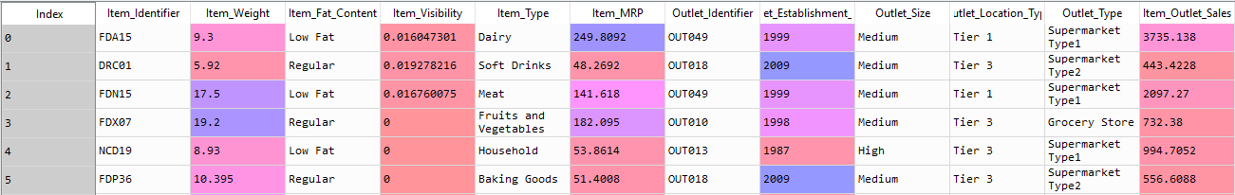
Find out the best Regression algorithm that generate the highest possible R2 score, and lowest possible RMSE
Objectives:

Slide 3
2 variables (Item Weight, Outlet Size) contained missing values: fill the nulls of Item Weight with mean (12.8576451841) fillthe nulls of Outlet Size with the value ‘Medium’.
preprocessing:
Item Fat Content contained some messy values (eg: ‘low fat’, ‘Low Fat’ and ‘LF’ are the same thing): fixed simply by bring them into conformity (‘Low Fat’).
useless features (Item Identifier, Outlet Identifier, Outlet Establishment Year) were dropped
dummy variables are created for all the categorical variables (Item Weight, Item Fat Content, Item Type, Outlet Size, Outlet Location Type, Outlet Type)

Slide 4
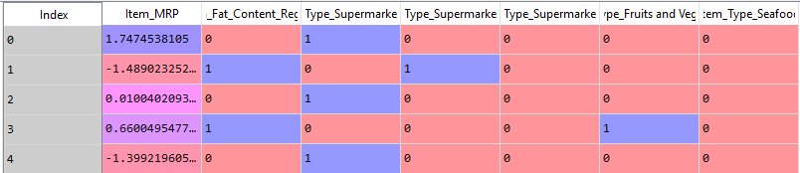
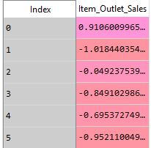
preprocessing:
standard scaling on numerical variables: Item Weight, Item Visibility, Item MRP, Item Outlet Sales(response variable)
Feature selection/engineering:
1 numeric variable: Item MRP, and 6 dummy variables: Item Fat Content Regular, Outlet Type Supermarket Type1, Outlet Type Supermarket Type2, Outlet Type Supermarket Type3, Item Type Fruits and Vegetables and Item Type Seafood are kept for future modeling

Slide 5
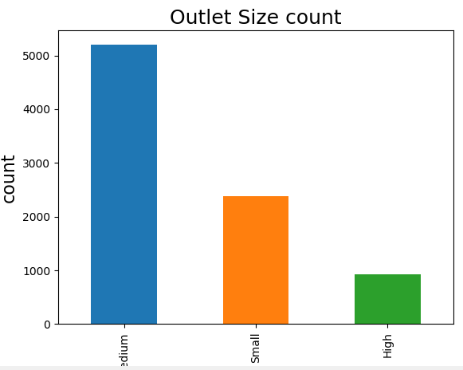
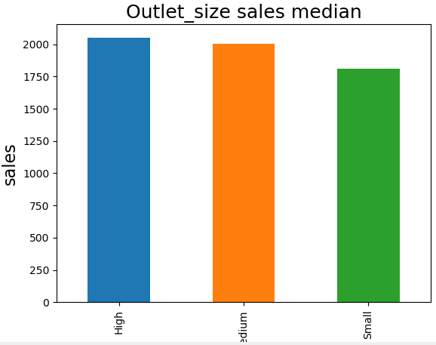
visualization: (categorical variables vs count, vs sales median)

Slide 6
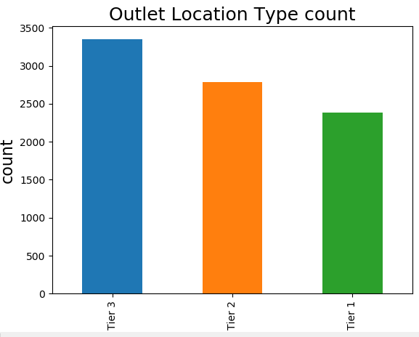
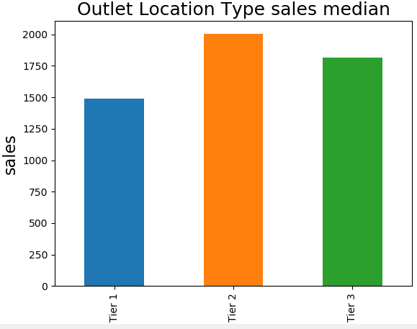
visualization: (categorical variables vs count, vs sales median)

Slide 7
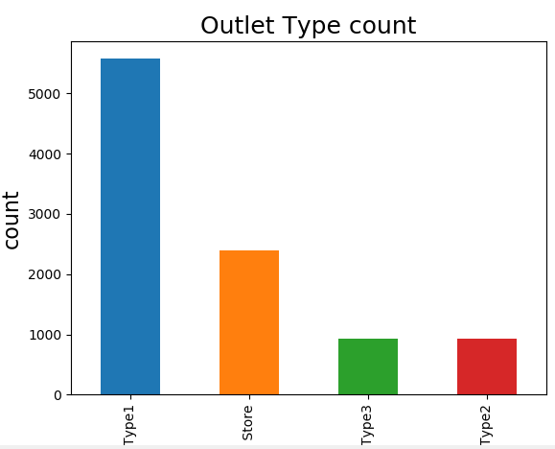
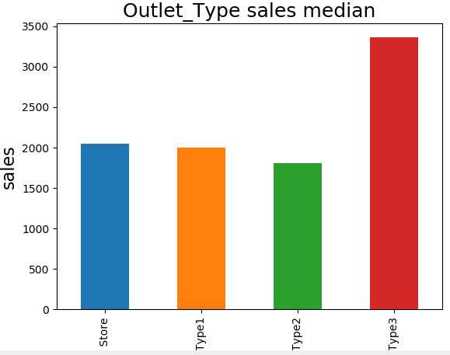
visualization: (categorical variables vs count, vs sales median)

Slide 8
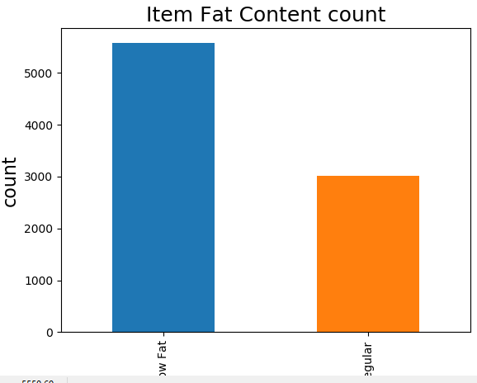
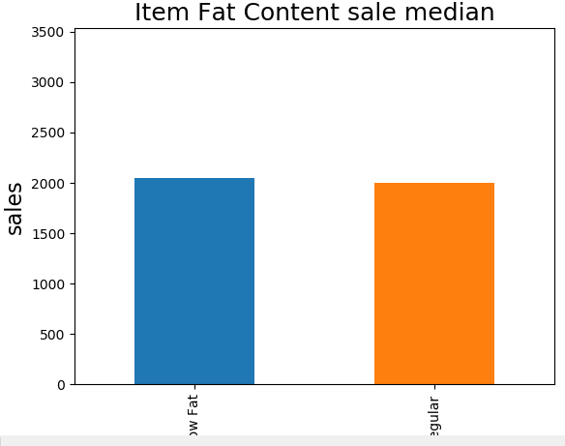
visualization: (categorical variables vs count, vs sales median)

Slide 9
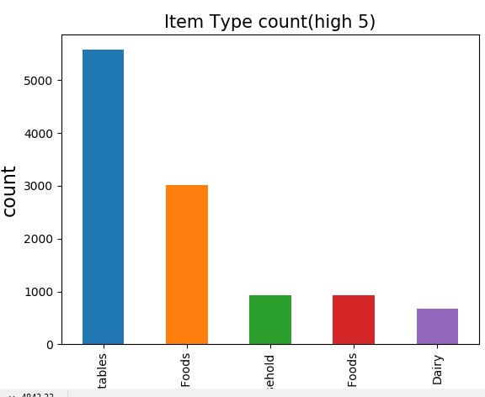
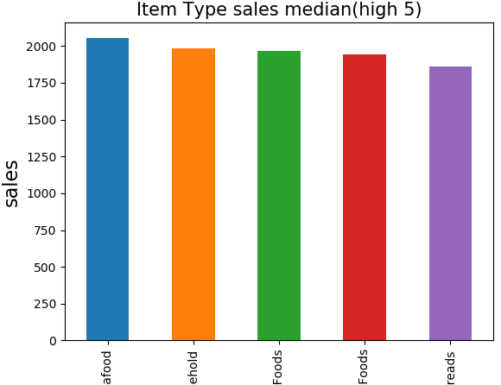


visualization: (categorical variables vs count, vs sales median)

Slide 10
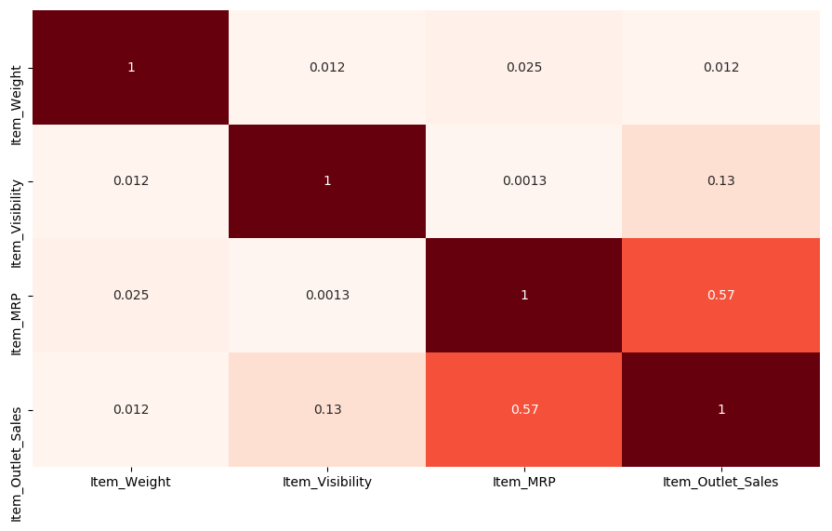
visualization: (correlation matrix for numerical variables)

Slide 11
linear regression, KNN, SVM and random forest were used
Regression Modelling:
R2, adjusted-R2 score, and RMSE are the criteria for best model
 | Linear regression | KNN | SVM | random forest
R2 | 0.5616 | 0.5780 | 0.3546 | 0.5971
Adjusted R2 | 0.5562 | 0.5728 | 0.3467 | 0.5921
RMSE | 1146 | 1124 | 1391 | 1099

Slide 12
Random forest is the best model.
Conclusion:
The 7 independent/ predictive variables(Item MRP, Item Fat Content Regular, Outlet Type Supermarket Type1, Outlet Type Supermarket Type2, Outlet Type Supermarket Type3, Item Type Fruits and Vegetables and Item Type Seafood) kept are not bad (moderate) predictors to predict item outlet sales.

